Slide 1
MM802 Mini-project
Presenters : Kushal Mahalingaiah and Harsh Sharma
Instructor : Dr. Mohammed Elmorsy

Slide 2
abstract
Visualization of crime mapping in the city of Vancouver to generate some public awareness.
Interactive GUI assisting the end user to obtain precise information.
Interesting way to gather information using Map and Graphs.
Trend analysis over the specified time period to check the growth or fall of crime rate.

Slide 3
Dataset summary
Dataset obtained from Vancouver Police Department in the form of csv, for years 2003-2019.
Details in the dataset includes: category of crime, location of crime in X-Y coordinates, neighborhood and hundred block details, time stamp (Year, Day, Month, Hour and Minute).

Slide 4
technical framework
Data Pre-Processing
Data Framework
Data Processing
Input CSV
Latitude & Longitude
readr
R
dplyr
GUI with Map and Graphs
Ggplot2 & leaflet
rsconnect
Shiny Server
Plotting Maps and Graphs
rgdal
Shiny UI

Slide 5
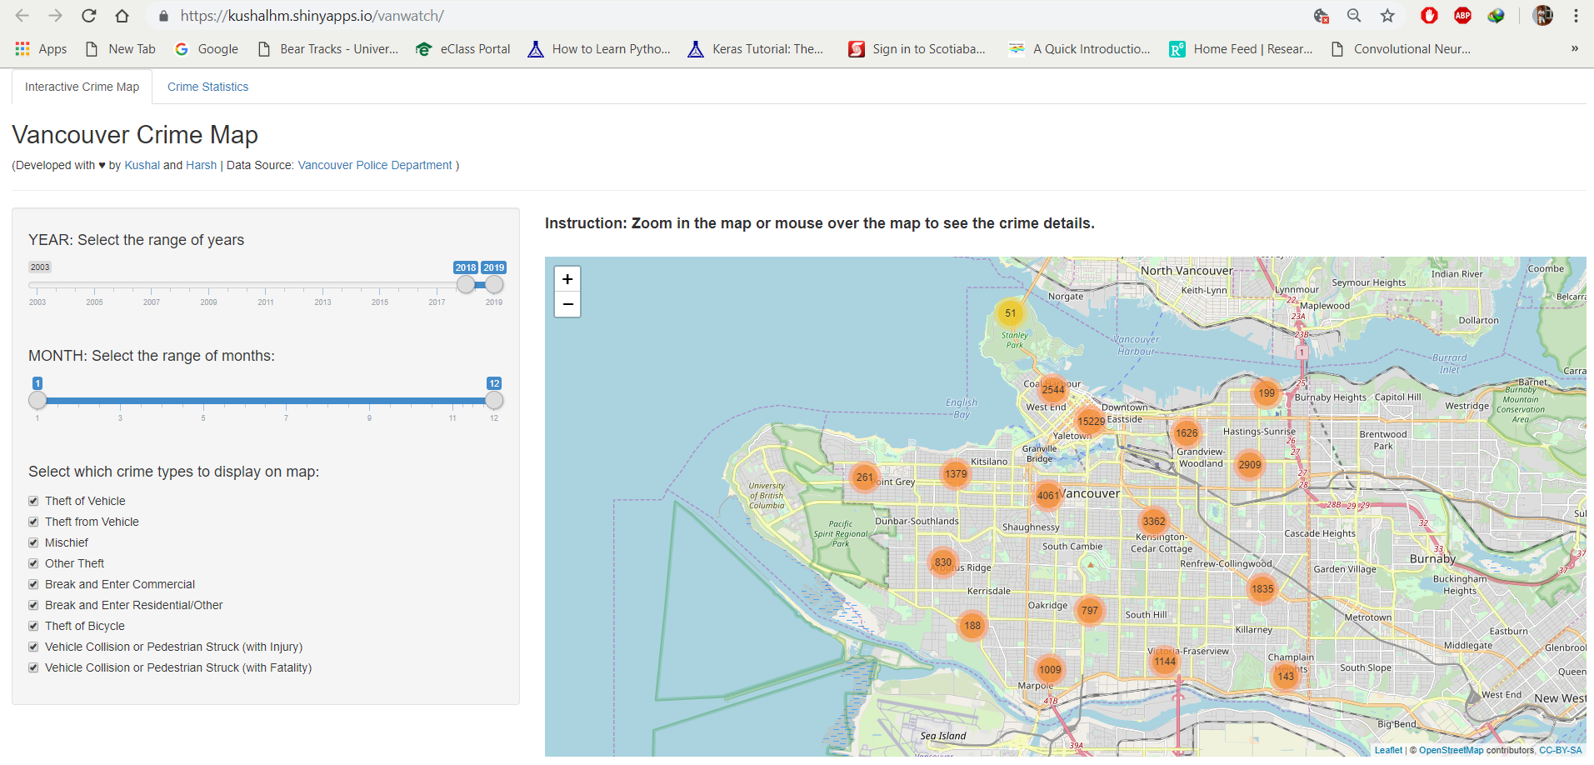
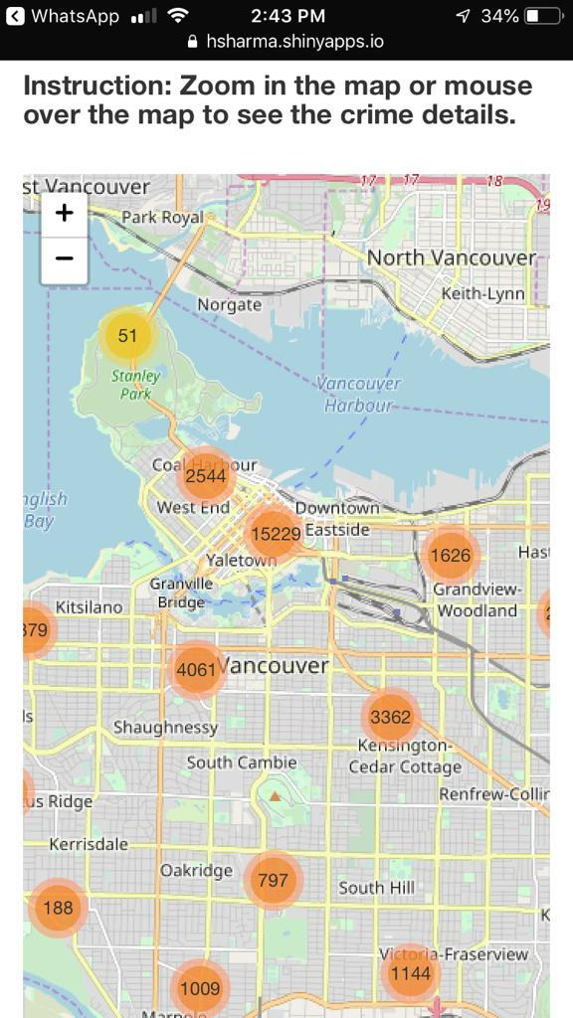
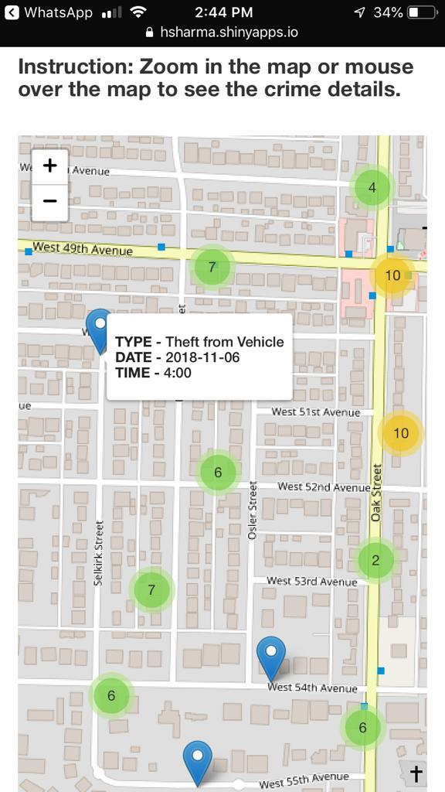
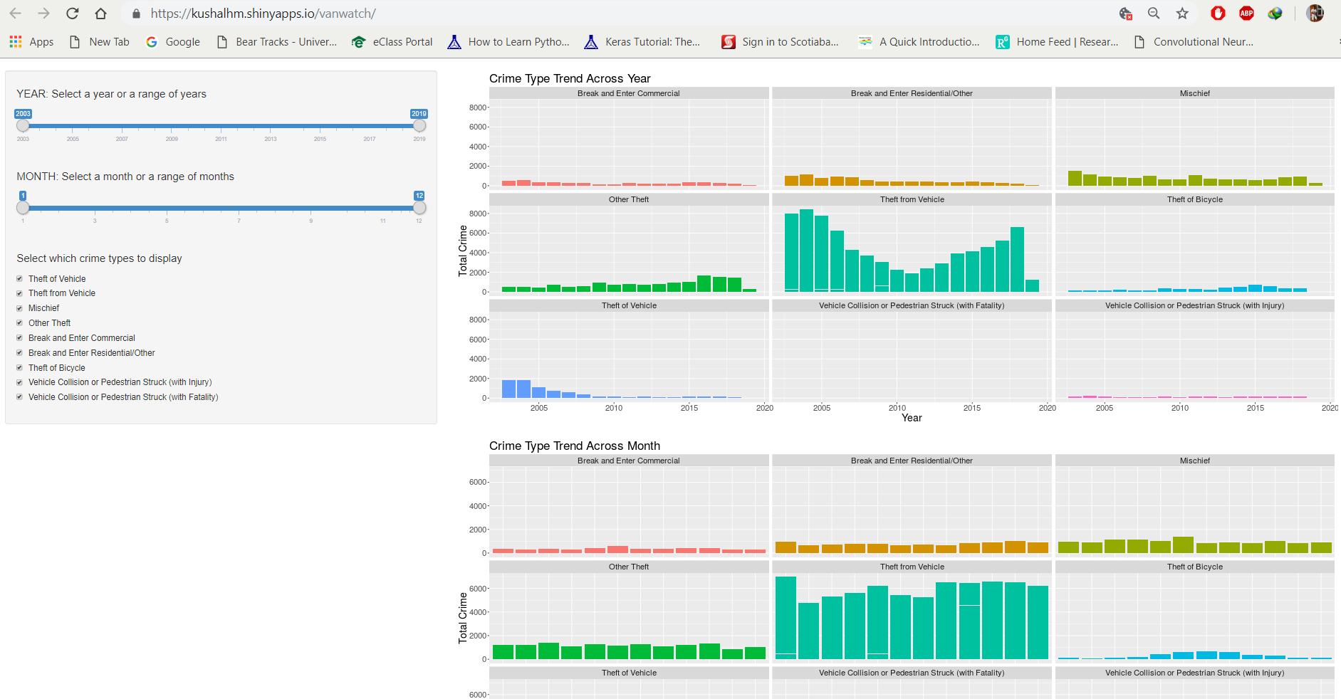
Mini-Project summary

Slide 6
Thank you
Deployed Application:
https://kushalhm.shinyapps.io/vanwatch/
https://hsharma.shinyapps.io/mm802a3/
Contact us at:
hosahall@ualberta.ca
hsharma@ualberta.ca

